Slide 1
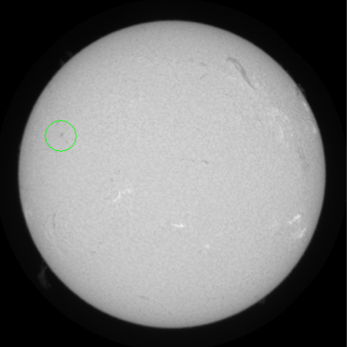
Sunspots
By Callum Burns, Jake Dodd and Niamh Caley

Slide 2
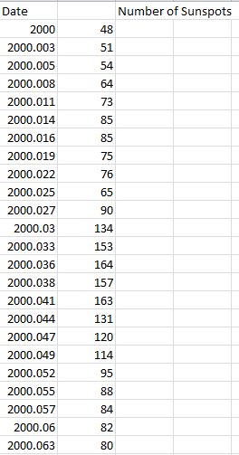
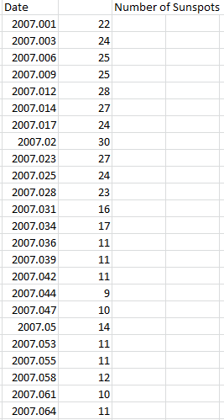
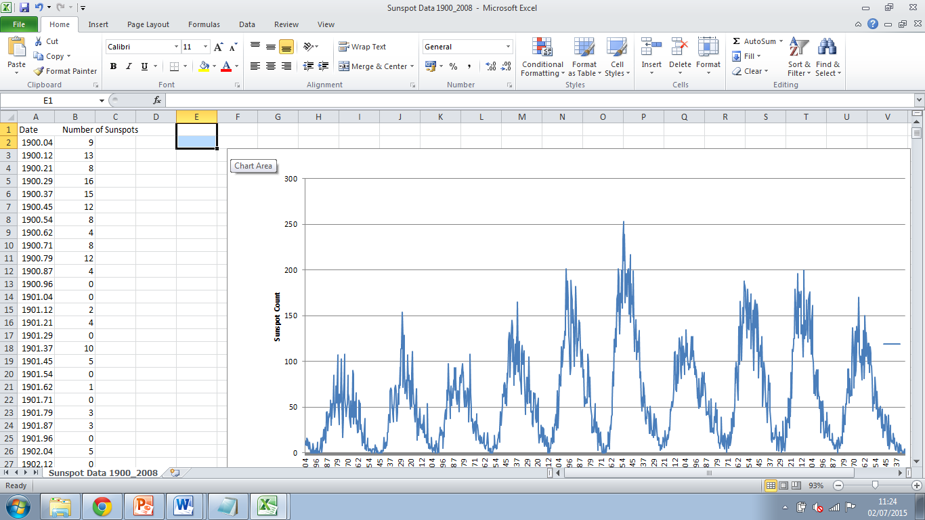
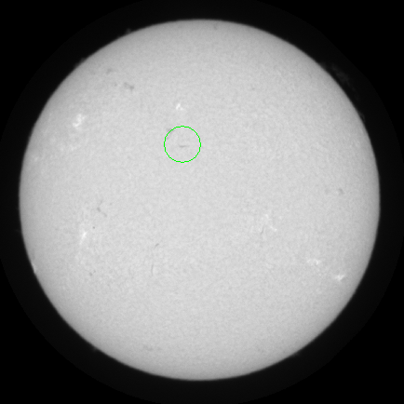
Targets & Dataset
We were asked to analyse data from 1900 to 2008 as well as data from 2000 and 2007.
Also we were asked to calculate the rotation period and angle of velocity and moment of Sunspots from images taken from the GONG Solar Telescope.

Slide 3
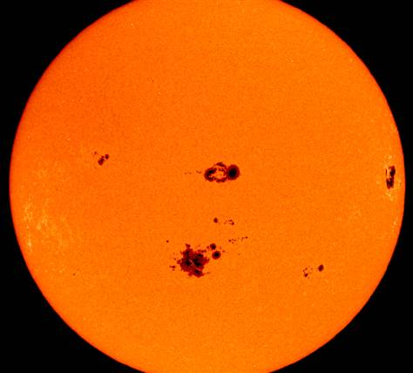
Background
Sunspots are temporary phenomena on the photosphere of the Sun that appear visibly as dark spots compared to surrounding regions. They are formed at certain points where the Sun’s magnetic field inhibits convection, thus reducing the surface temperature at that point (approximately 3000-4500K). At Sunspots, secondary phenomena such as solar flares and coronal mass ejections may occur. Most solar flares and coronal mass ejections originate in magnetically active regions, mainly around visible Sunspot groupings.
An example of a Sunspot.

Slide 4
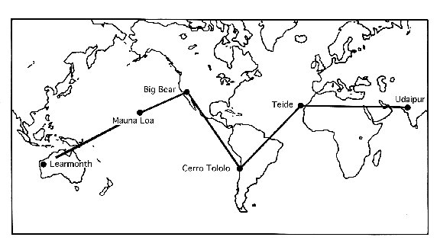
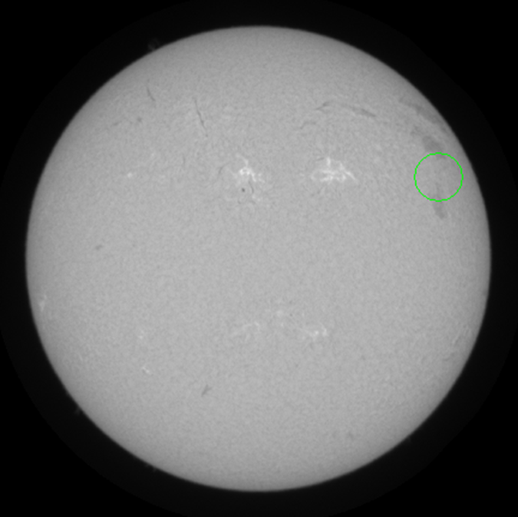
GONG Solar Telescope
GONG has developed a six-station network of extremely sensitive and stable velocity imagers located around the Earth to obtain 24-hour a day observations of the Sun.
We used images from the Observatorio del Teide in the Canary Islands to observe the angular rotation and rotation period of three different Sunspots. These images were taken using a H-alpha filter, so the Sunspots were more visible and were easier to track.

Slide 5
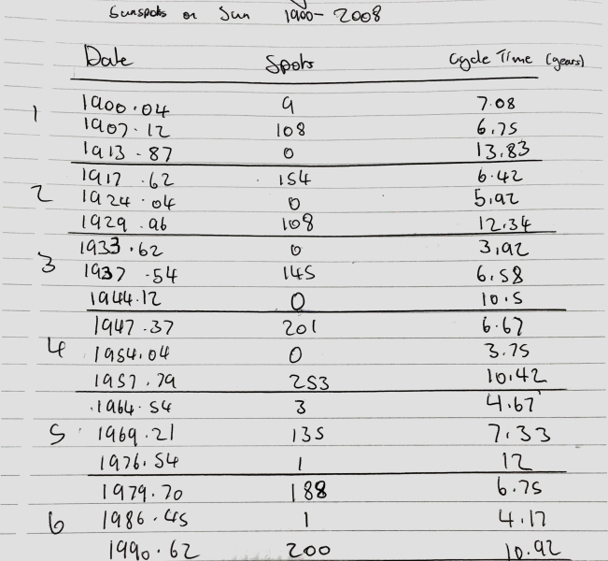
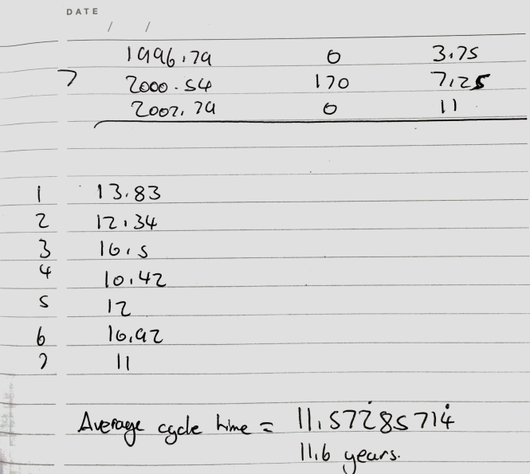
Method of analysis
From the data we were given we made three separate graphs to show the number of Sunspots at different times. We worked out the average number of years for one cycle by calculating the solar maximums and solar minimums from 1900-2008. we worked out the time it took for each of the seven cycles we found between these dates and used the data we got to calculate an average time taken for one cycle.

Slide 6

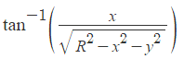
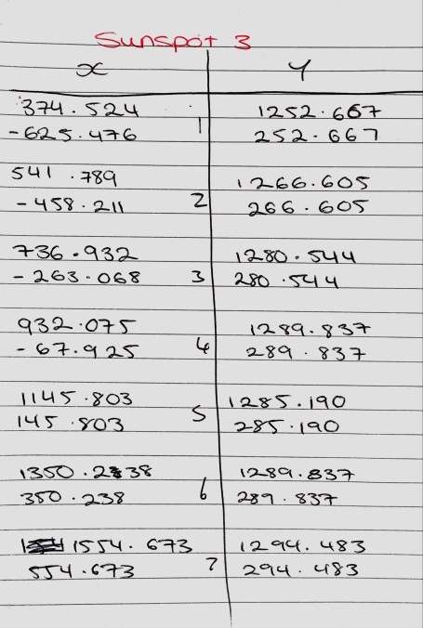
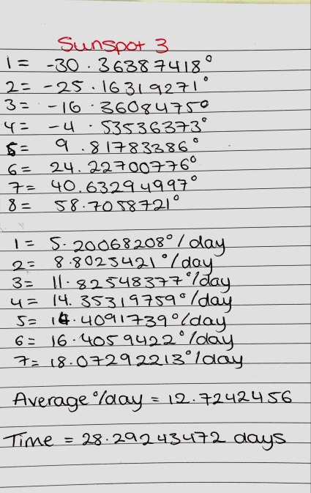

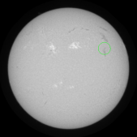
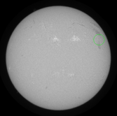
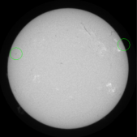
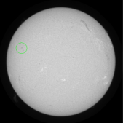
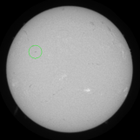
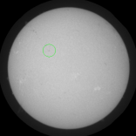
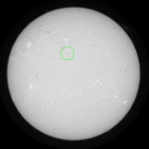
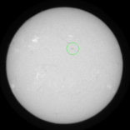
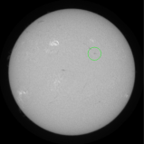
Method of analysis
To work out the time it would take for a Sunspot to complete one full rotation we had to calculate the angle at which the Sunspot spins on the Suns axis as well as the speed it travels.
To work out the angle at which the Sunspot was moving relative to its poles we had to map out the Sun on axis to gain values for X and Y so we could use the formula.
We had to work out the angle of each of the different positions of the Sunspots as it moved. From this we worked out the difference between these angles to give a value of the velocity of the Sunspot in degrees/day.
From all of the values we calculated for the angular velocity we worked out the average velocity that the Sunspot was moving.
We then worked out the time it would take for the Sunspot to complete one full rotation by dividing 360 by the average angular velocity of the Sunspot.

Slide 7
Results
Using the data for the Sunspot readings between 1900 and 2008, we imported the results into Excel and were then able to produce a graph which clearly showed the pattern across the 108 year period. We worked out the length of each cycle by analysing the data to find the lowest and highest number of sunspots, and therefore calculated an average length of the cycle – 11.6 years. Using the same process, we produced graphs for the Sunspot readings across the year 2000 and the year 2007, thus allowing us to compare these patterns.
These are the graphs we produced from the data we handled showing the amount of Sunspots on the Sun over different periods of time.
They show the peaks and troughs of the solar minimum and maximums.

Slide 8
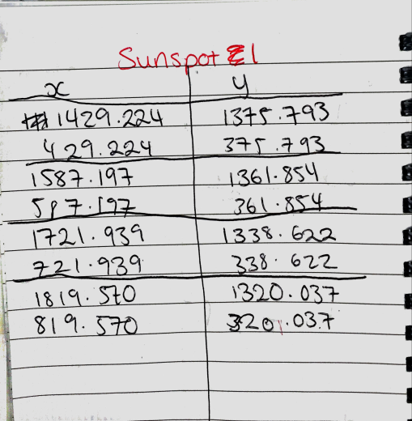
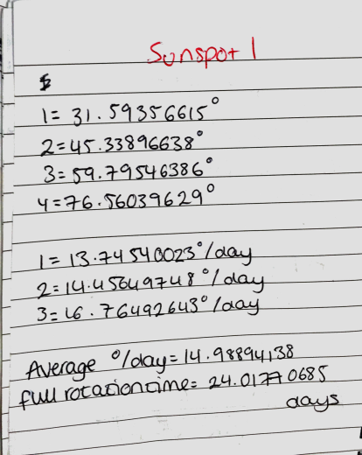
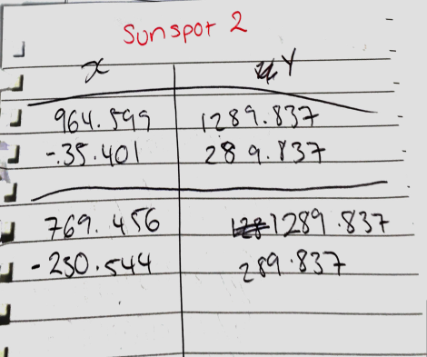
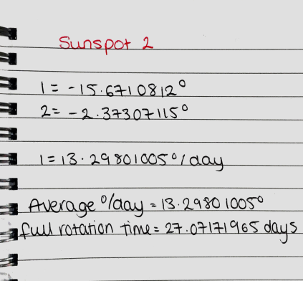
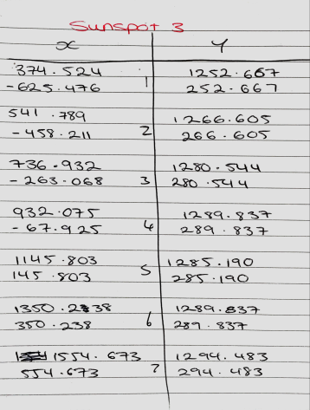
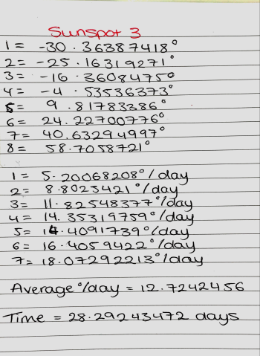
Results
We gained and calculated results from three Sunspots on the Sun.
The first Sunspot we followed produced an anomalous result of an average angular velocity of 14.99 degrees/day, the result was anomalous as it was estimated to take under 25 days to complete one full rotation at 24.01 days/full rotation. This Sunspot was the one out of the three with the lowest latitude as it was the nearest to the equator.
The second Sunspot we looked at produced a more understandable result. Its average angular velocity was 13.39 degrees/day and its estimated time for one full rotation was 27.07 days/full rotation. This Sunspot was positioned at a middle latitude compared to the other two Sunspots.
The third and final sunspot we followed also gave an understandable result. We calculated its average angular velocity was 12.72 degrees/day and therefore its estimated time to complete one full rotation was 28.29 day/full rotation. This Sunspot was at the highest latitude of the three as it was the furthest from the equator.

Slide 9
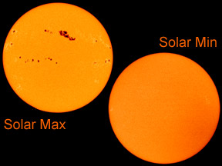
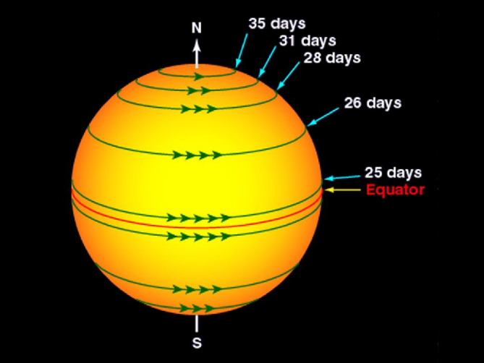
Conclusion
From our graphs we can conclude that an average Sunspot cycle lasts for approximately 11 years. Within these 11 years, the amount of Sunspots fluctuates, ranging from a solar minimum to a solar maximum. Across each year, there are also fluctuations in the amount of Sunspots counted, and the reason for this is unknown. Overall, the amount of Sunspots’ increases or decreases depending on which stage of the cycle it is at.
From our calculations we determined that the Sunspot with the highest latitude (furthest from the equator) travelled the slowest, as it has the smallest angular velocity. We found that, as the latitude decreases, the angle of velocity increases; therefore it takes less time for a Sunspot to complete a full rotation.

